Slide 1
Creating Comprehensive Personas | Anthropologie.com
By: Maggie Pruitt

Slide 2
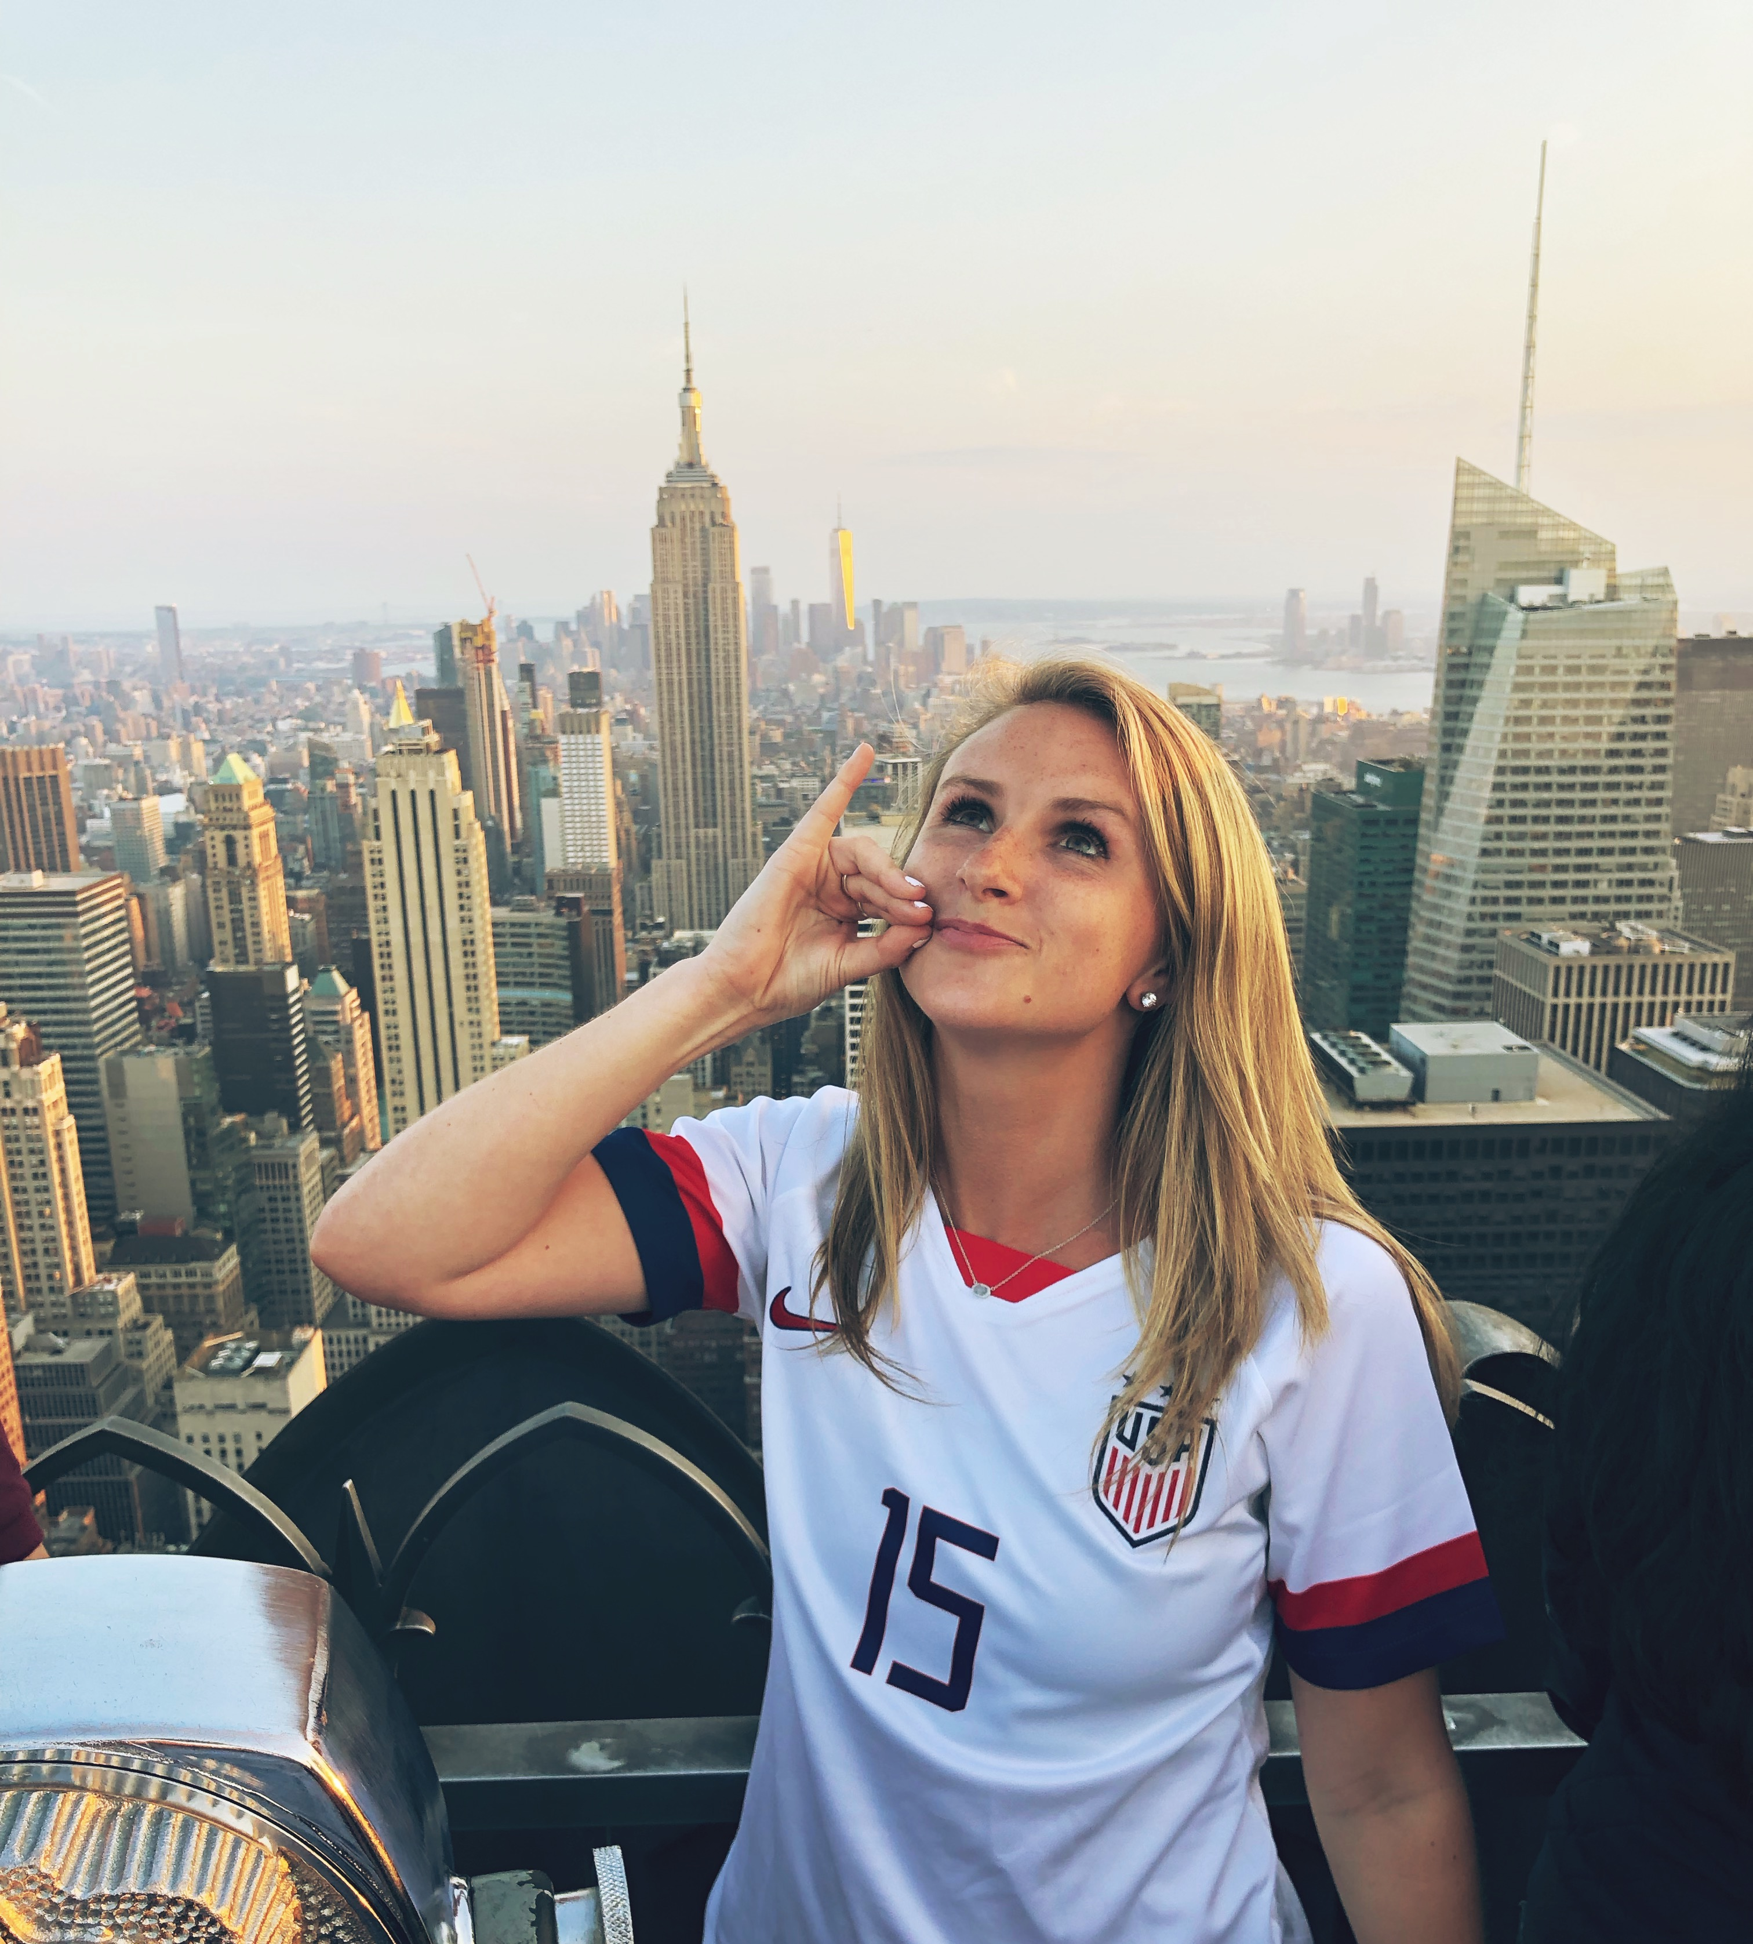
Maggie Pruitt (ME)
The Young Professional
“When I online shop, half of the experience is dependent on how the website makes me feel. Anthropologie is one of my favorite sites because my shopping experience is always a great one and I feel inspired.”

Slide 3
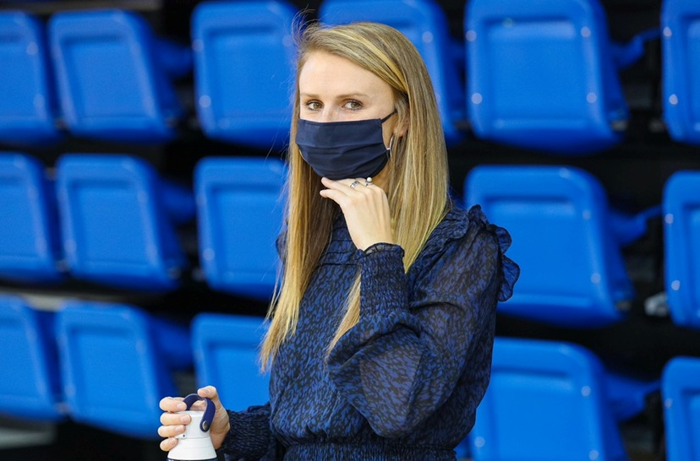

demographics
Mid-20s Female – Works Full Time
Online Shopper
College Educated

Slide 4
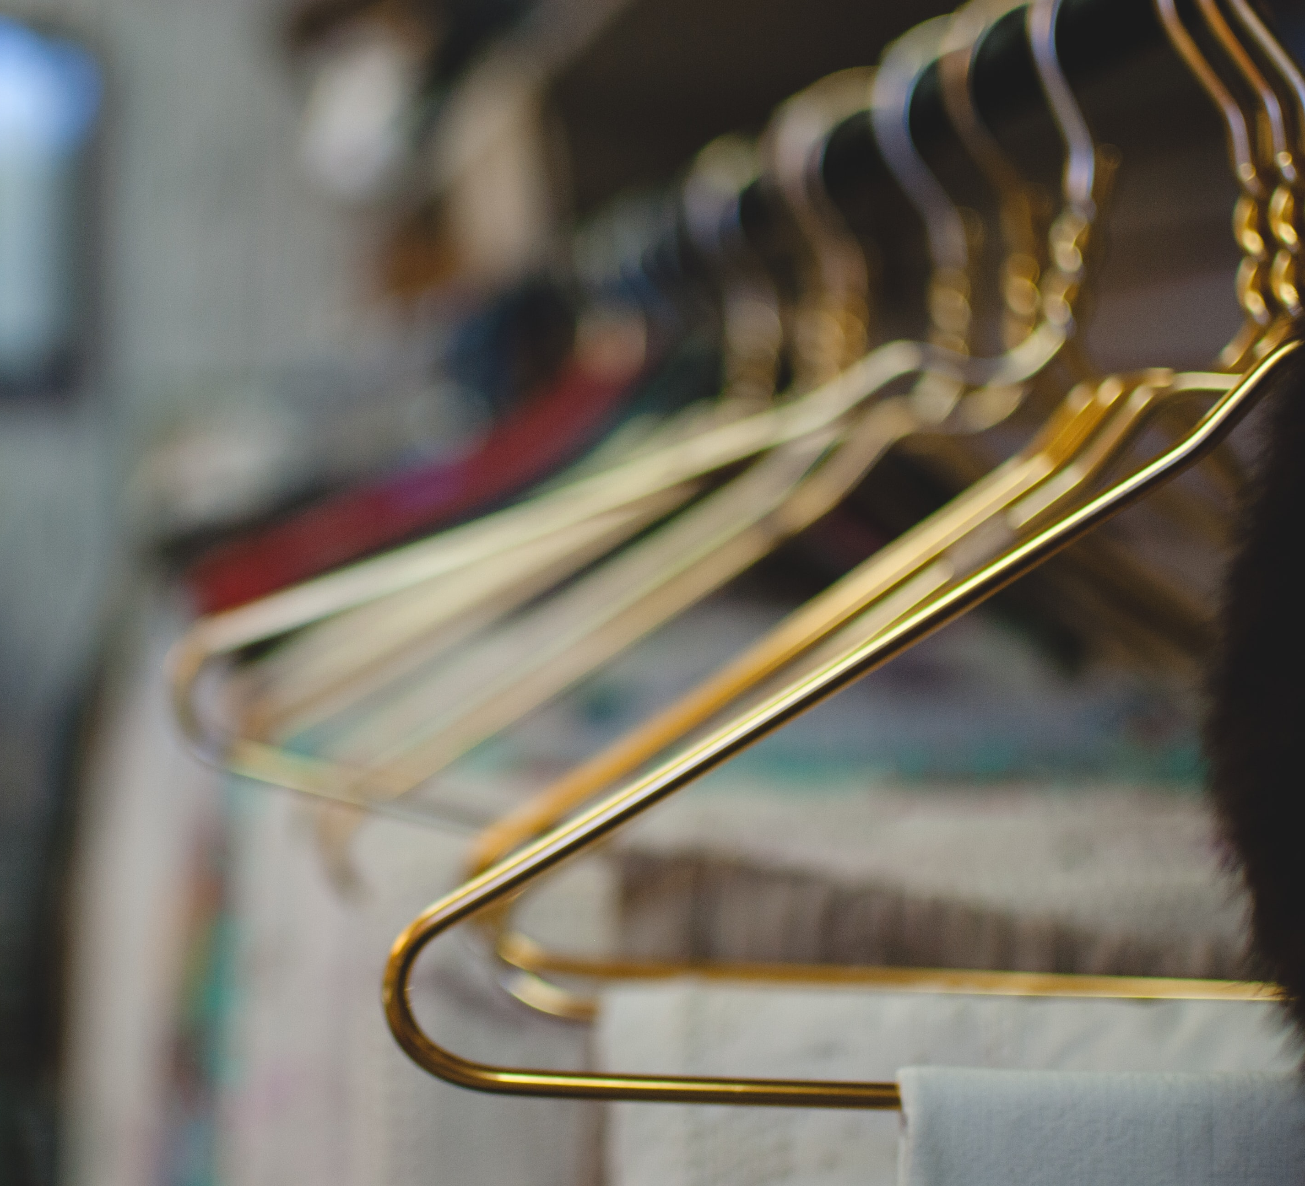
Goals & actions
- Maggie wants to have a wardrobe that expresses her personality. With so many things taken away this year, dressing up and having fun while styling outfits feels normal and enjoyable.
- She wants to have fun while shopping and find new things.
- She wants her home to feel like home and to resemble her personality (with Anthro home items).
- She wants to have great quality clothes even if that means spending a little more $.

Slide 5
Journey
- Maggie has always been creative and has always enjoyed fashion and styling.
- She is happy when she is able to wear something that is unique and cool.
- She enjoys creating outfits that express her creativity.
- She lives with the “Look Good, Feel Good” mentality.

Slide 6
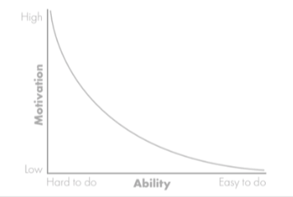
Motivation vs ability
Motivating Factors - Sales, a good deal or a gift card to use towards purchasing
Inhibiting Factors – Price is too high, sold out online, no in-store pick up
Possible Triggers – Good deal, sales, new arrivals, having more free time
If the purchase is simple with an extra bonus of a sale, the end goal of online shopping is easy.

Slide 7

influencers
Friends & Co-workers
Instagram & Its Influencers

Slide 8
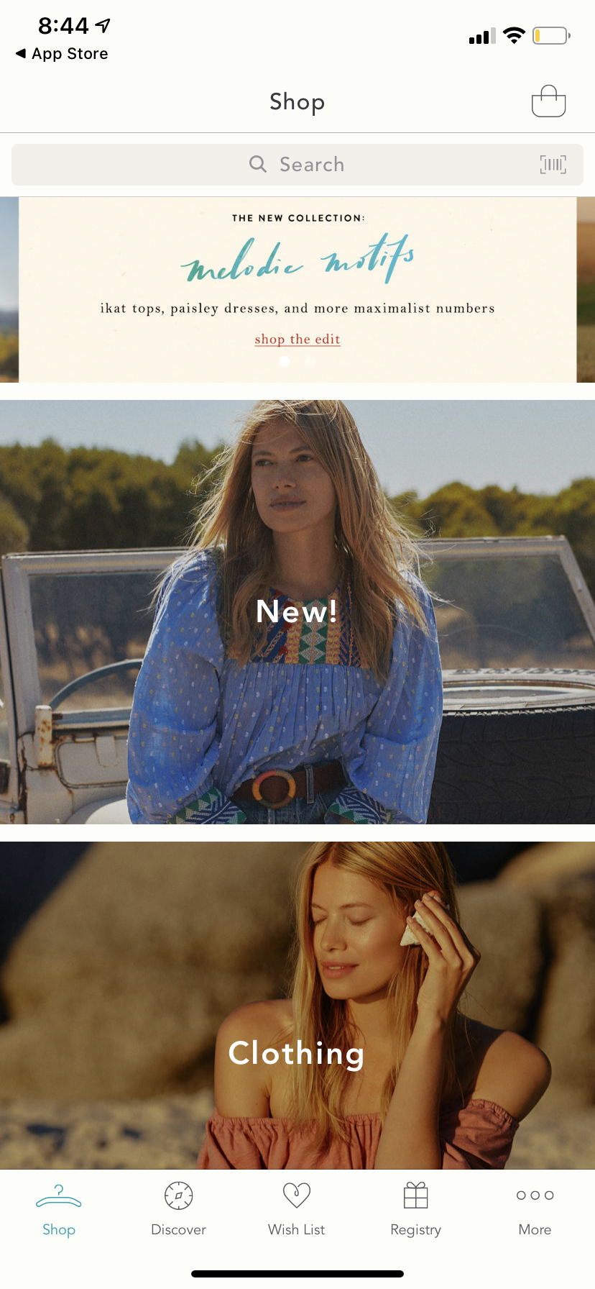
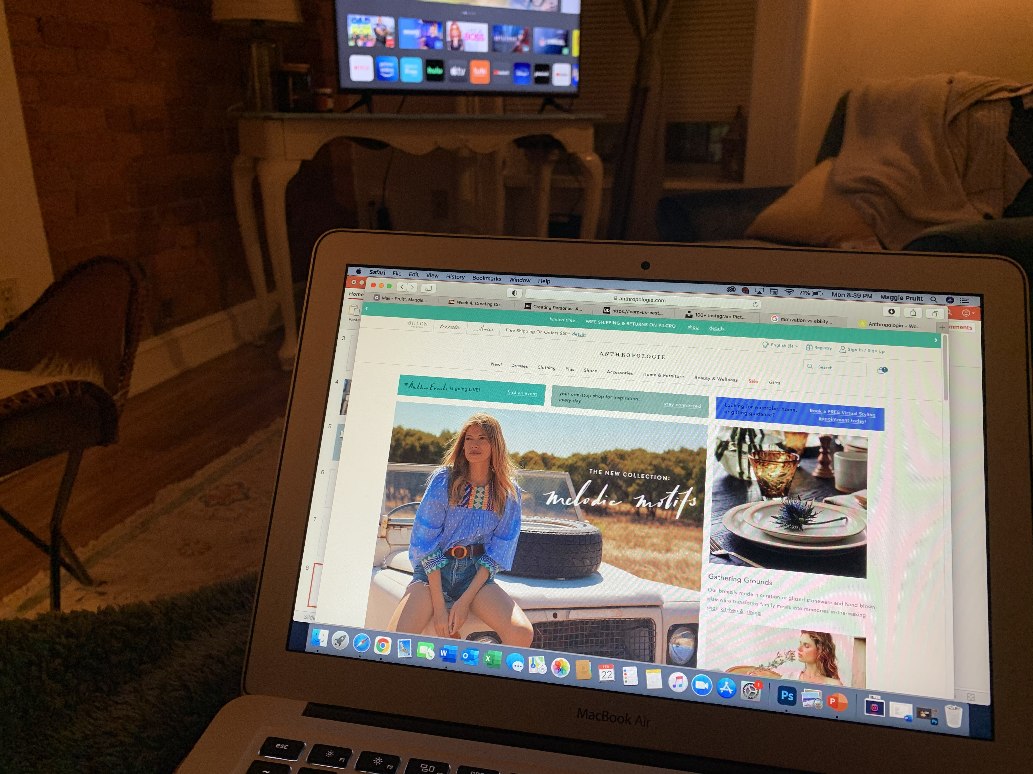
Environment
On the Computer
-Will browse when bored
-Will also use the computer when she wants to see full pages rather than on a phone
On the Phone
-Will browse when bored or waiting for something
-Will scroll at home to see what is new

Slide 9
Similar personas
The Influencer – woman who enjoys fashion blogging on social media
The Stay-at-Home Mom – woman who stays at home with children during the day, enjoys going to the gym and shopping, husband works
The Empty Nester – the woman whose children have all gone off on their own, she has a lot of free time, most likely was a stay-at-home mom, but is not any more. Works part time at Anthro in the store

Slide 10
Persona matrix
High Income
Stay-at-Home Mom
The Influencer
Really Busy
A lot of free time
Young Professional
The Empty Nester
Low Income

Slide 11

Christina cooper
The Influencer
“My followers are like my family. I want them to feel like the know everything about me, including where my outfits and stylistic inspiration comes from."

Slide 12
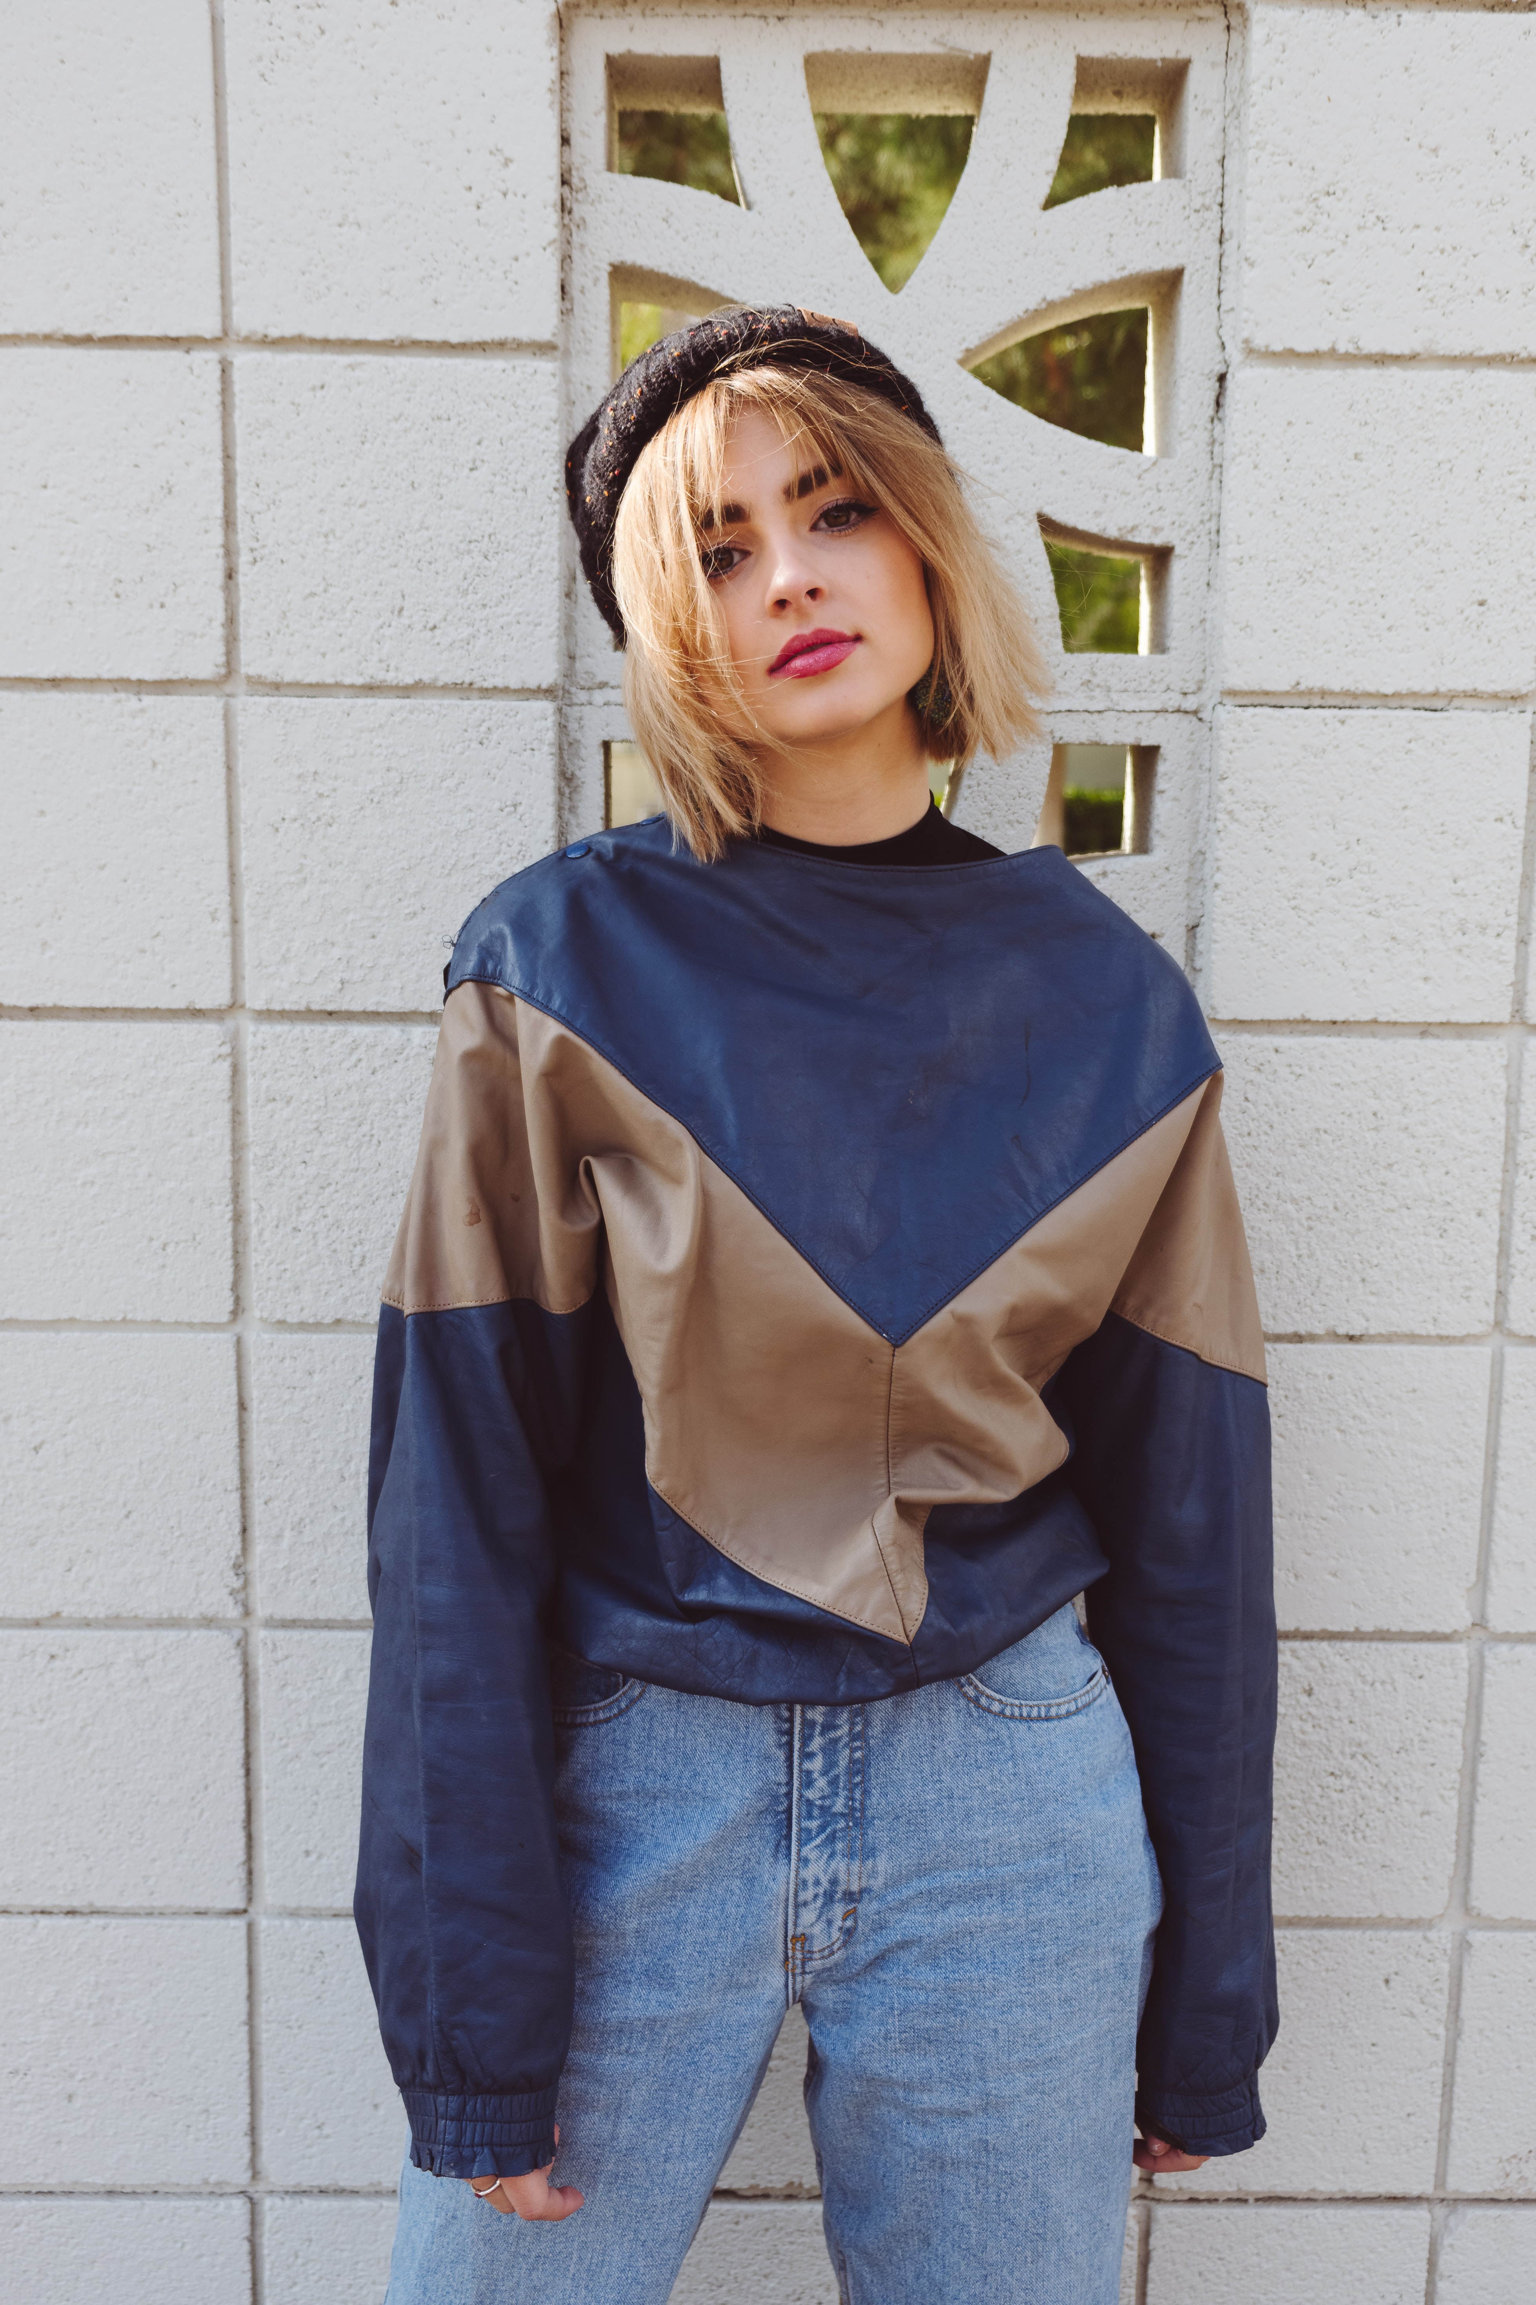
demographics
Mid-20s Female – Works as an Influencer Full-Time and somehow makes enough $ to live in a NYC apartment
Online Shopper
College Educated

Slide 13
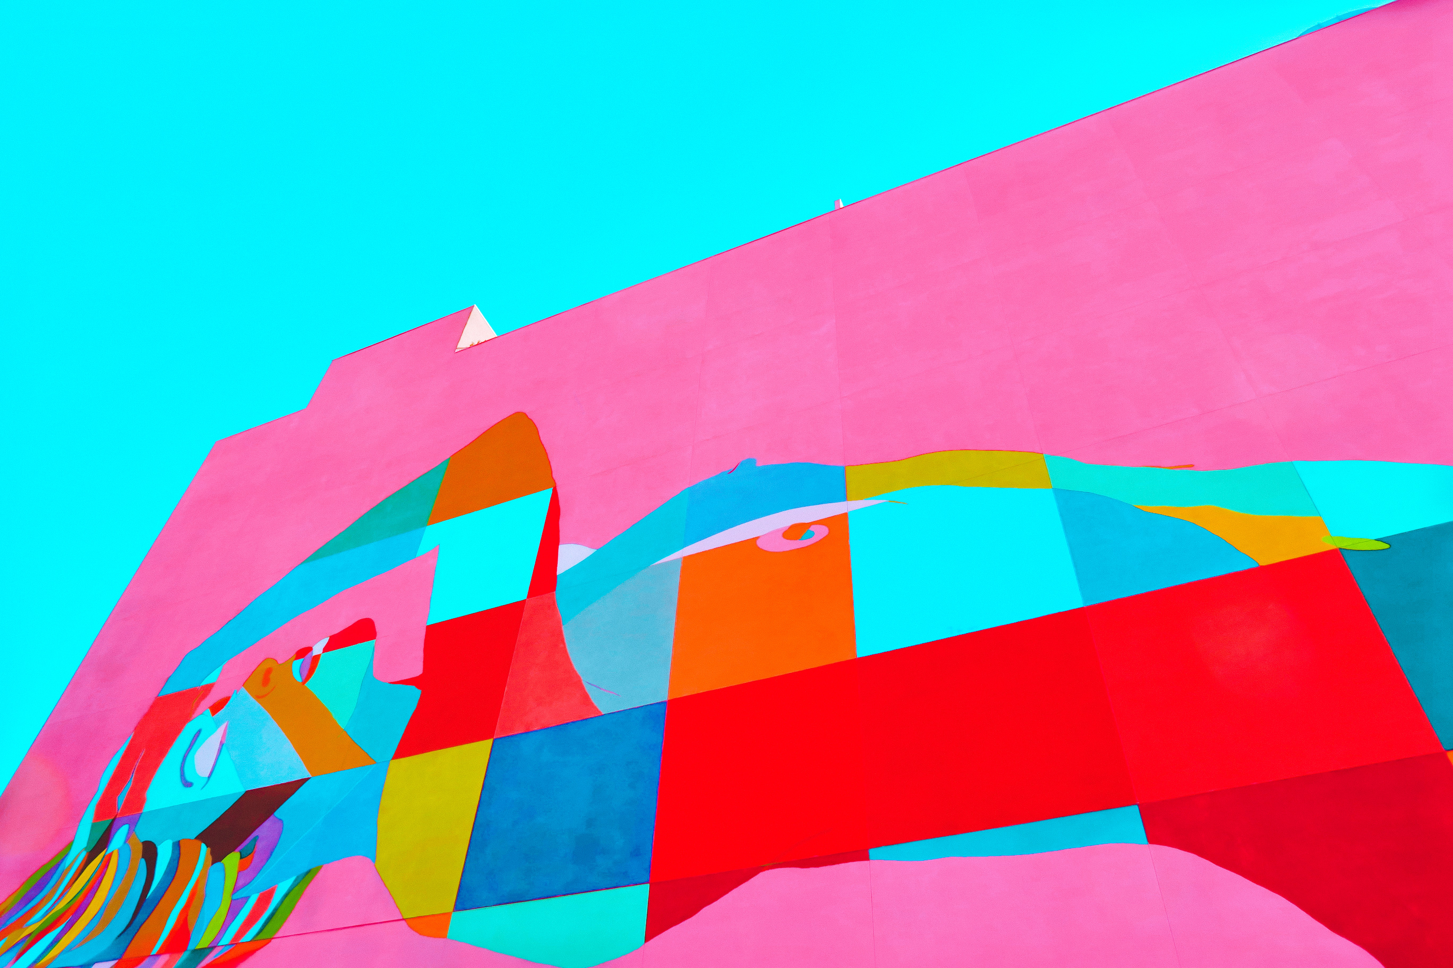
Goals & actions
- Christina wants to continue to make money through her sponsored posts.
- She wants to feel love through her social media followers and audience.
- She wants wants to dress up and show followers new trends.
- She enjoys creating content that appeals to a big audience.
- She has enjoyed watching her followers grow.

Slide 14
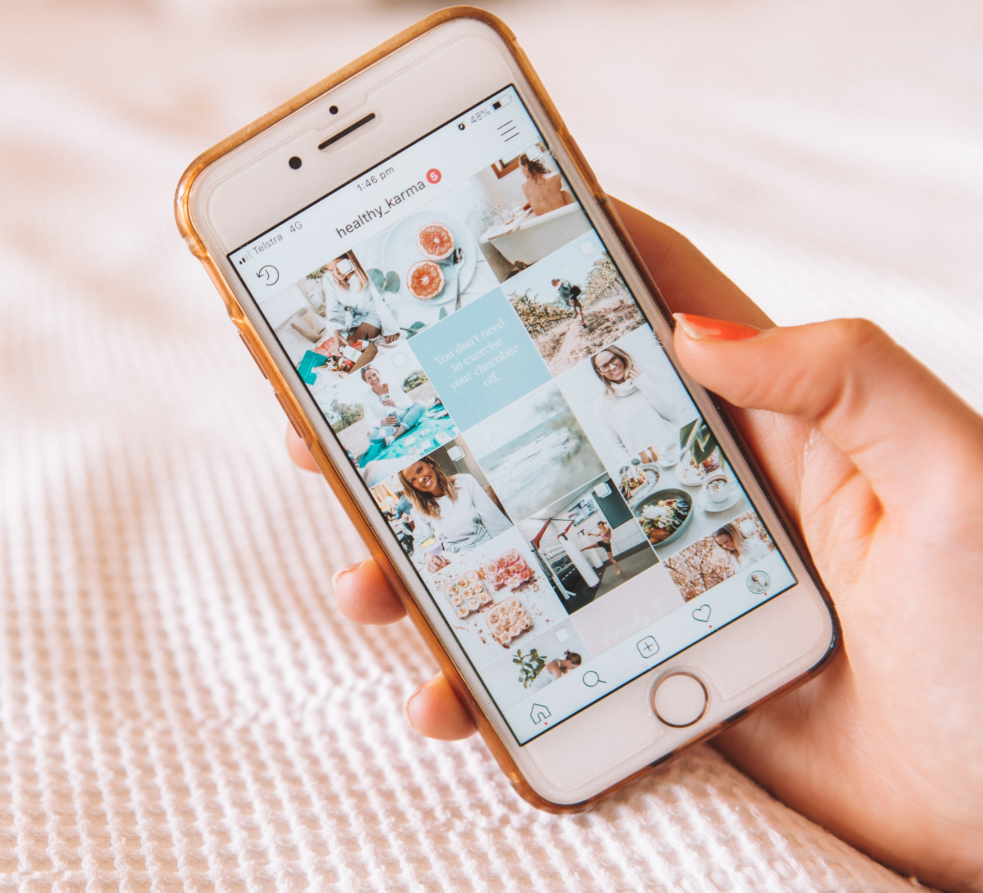
Journey
Christina is happy when her Instagram posts do well, and her engagement is up.
She is happy when she sees someone else take joy in her posts.
She enjoys finding the newest trends and piece of fashion for Instagram.
She enjoys growing her “brand” over time

Slide 15

Motivation vs ability
Motivating Factors – the newest products, getting more money per post, gaining followers, “is there a current sale?” so she can alert followers
Inhibiting Factors – “Will my followers like this?” “Is this product too expensive for my followers?”
Possible Triggers – Current sales, a new season arriving, great photography
If the product is on sale (will boost the Instagram) and is on brand with Christina’s brand, then the purchase or sponsorship will be easy.

Slide 16
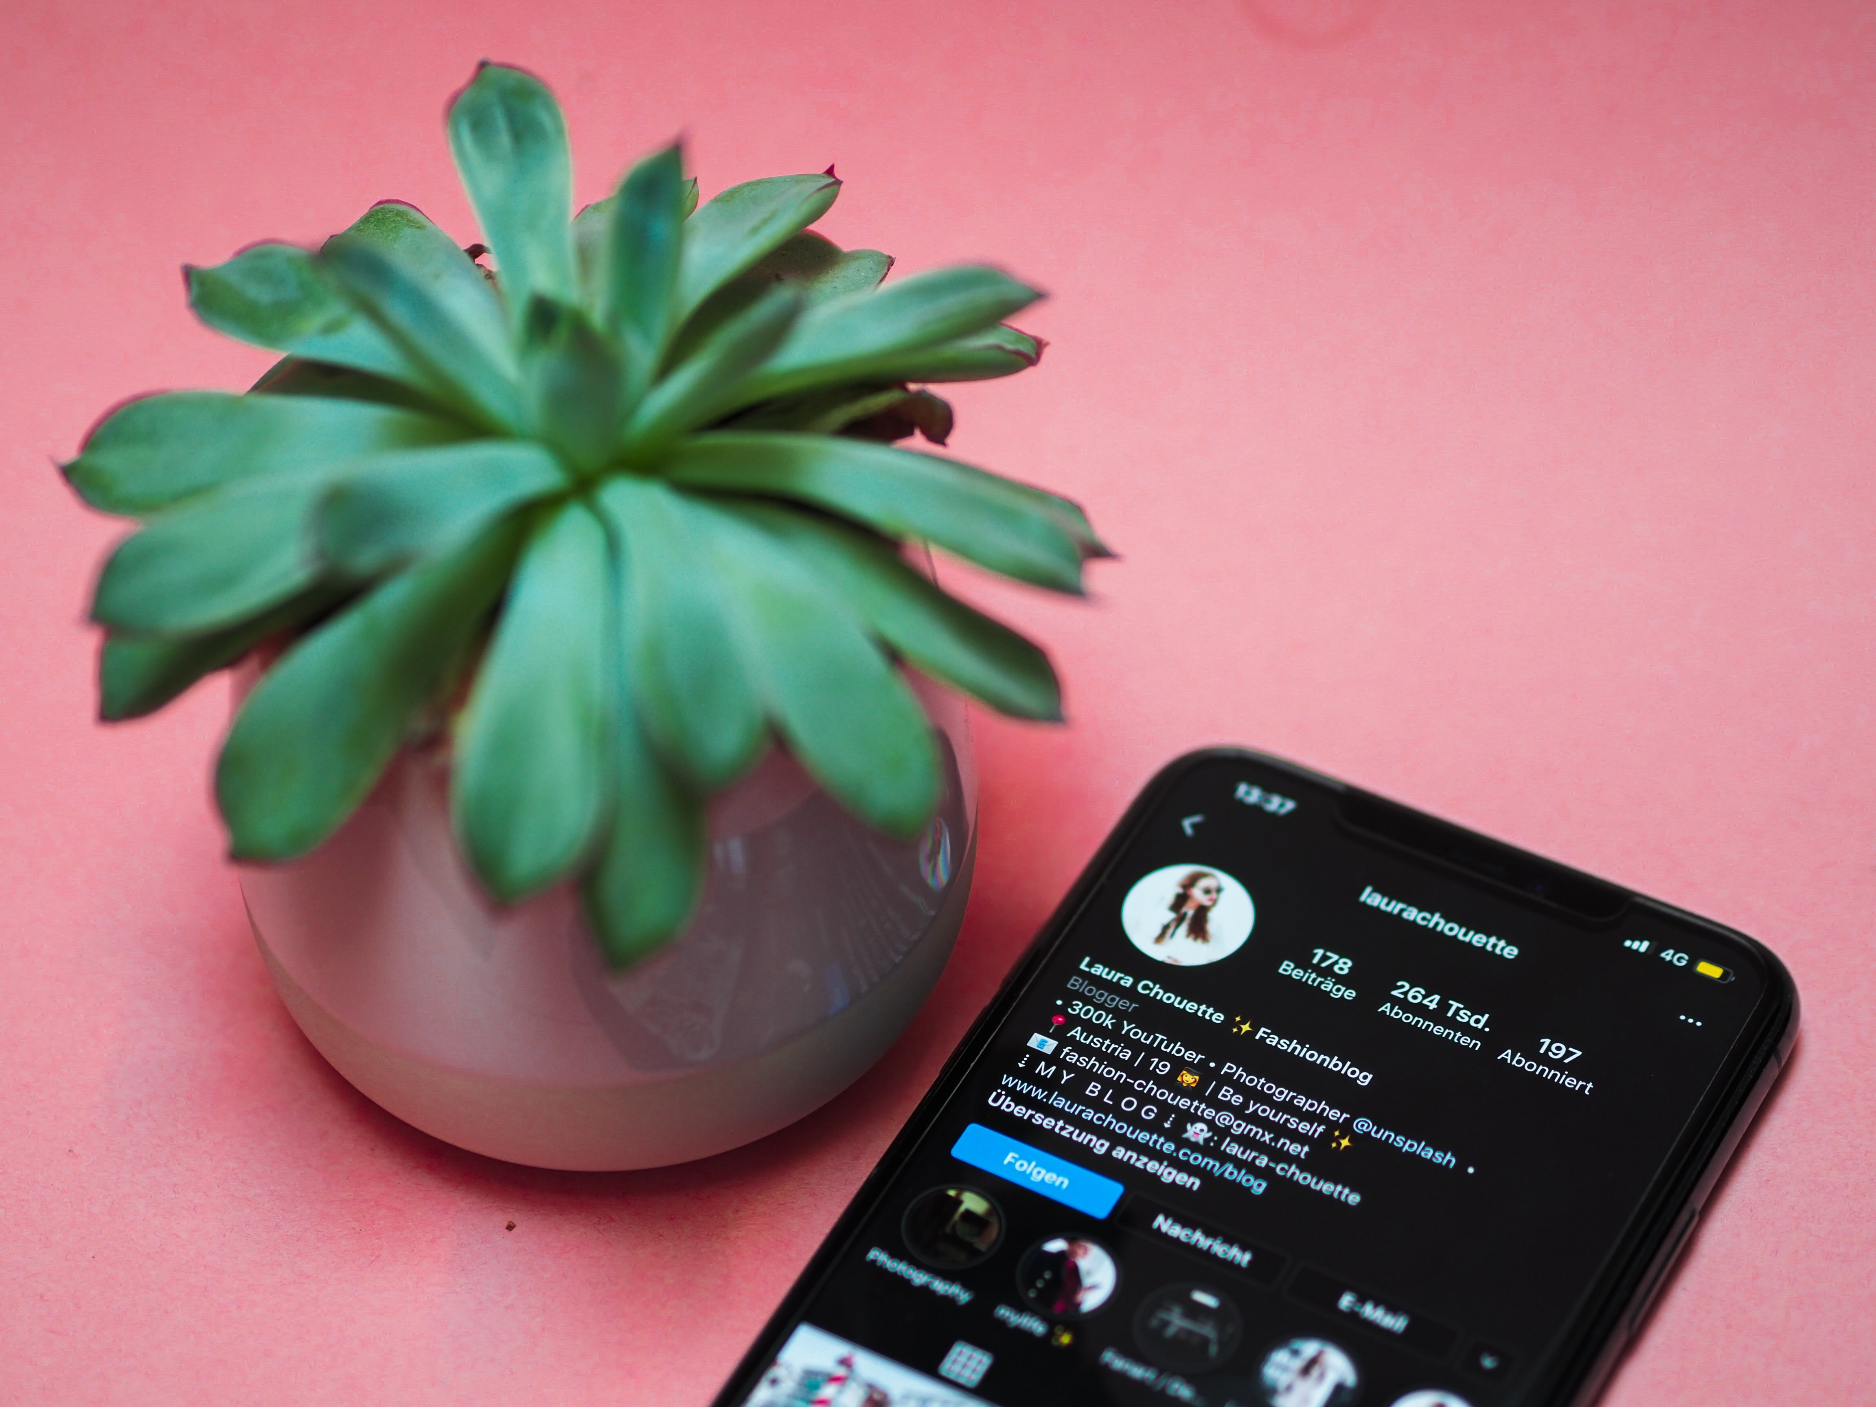

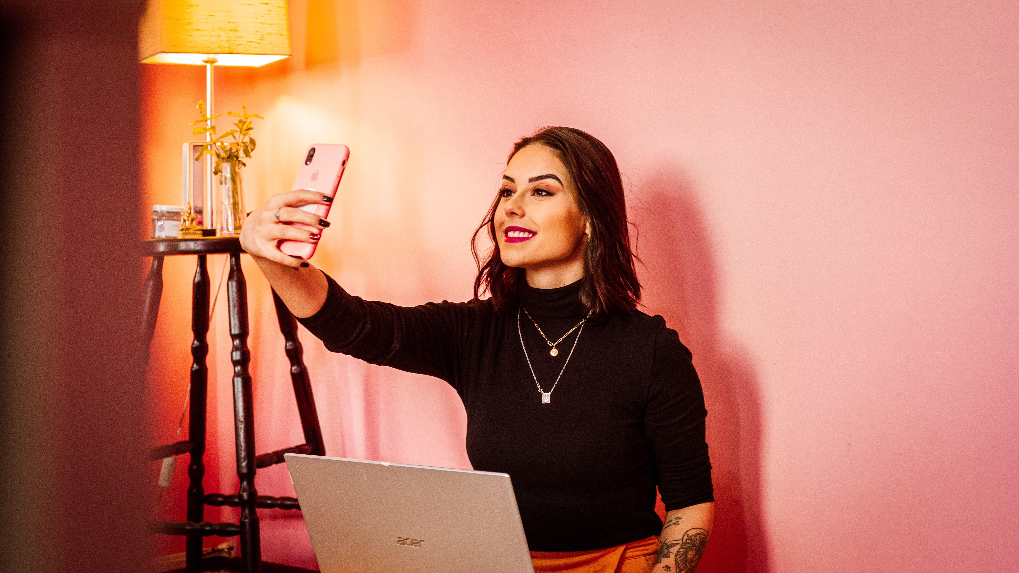
influencers
Her Followers
Other Influencers
The brands, products or people that are paying her to showcase their products (Anthro)

Slide 17

Environment
On the Computer
-Will browse when bored
-Will also also use email to communicate with sponsors (Anthro)
On the Phone
-Will use for quick surfing
-Looking for new products
-Looking at photography of clothes/models

Slide 18
Similar personas
The Young Professional – woman who enjoys the Anthro brand and mission and loves to shop online and in-store
The Stay-at-Home Mom – woman who stays at home with children during the day, enjoys going to the gym and shopping, husband works
The Empty Nester – the woman whose children have all gone off on their own, she has a lot of free time, most likely was a stay-at-home mom, but is not anymore. Works part time at Anthro in the store
(All of these personas would most likely follow The Influencer on social media)

Slide 19
Persona matrix
High Income
Stay-at-Home Mom
The Influencer
Really Busy
A lot of free time
Young Professional
The Empty Nester
Low Income

